Slide 1
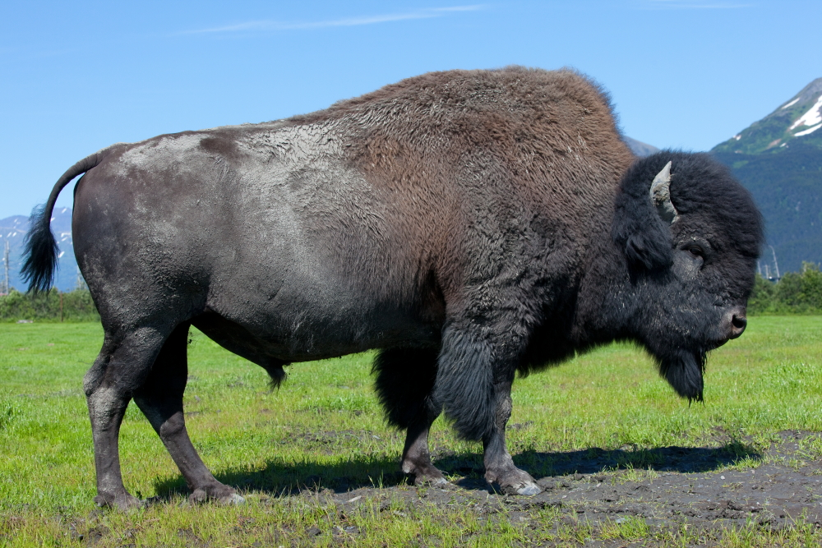
Where Will the Wood Bison Roam?
Copyright: Bear Trust International, Alaska Wildlife Conservation Center, Inspired Classroom 2012
Photos of wood bison generously donated by Doug Lindstrand
Power point slide show created by Melissa Reynolds-Hogland/Bear Trust International

Slide 2
Where Will the Wood Bison Roam?
As part of this activity, it will be your job to help determine
WHERE a captive herd of wood bison can be restored back
into the Alaska wild
Before you can help make this decision, you need some
background information

Slide 3
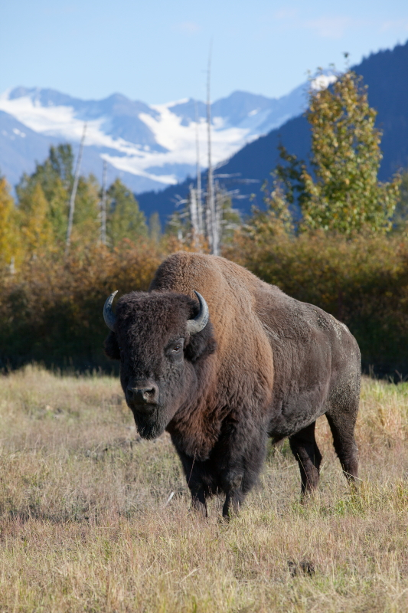
Background Info
Before the 1900s, wood bison had inhabited
Alaska for thousands of years
By 1900, wood bison were extirpated from
Alaska…...
.and only about 400 wood bison
lived in North America (they lived in Canada)
In 1973, the wood bison was listed as an
endangered species under the Endangered
Species Act
In June 2012, the US Fish and Wildlife Service
lowered the status of wood bison from
“endangered” to “threatened”

Slide 4
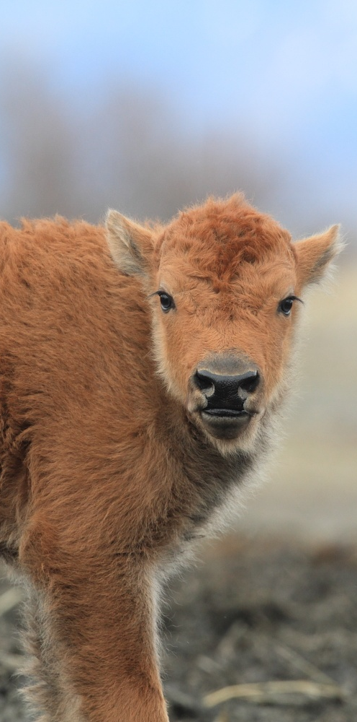
Background Info
Today, thanks to conservation efforts in
Canada, there are currently over 4,000
healthy, free-ranging wood bison in Canada
BUT! There are currently NO wood bison
living in the wild in the United States
So....
the Alaska Department of Fish & Game
and Alaska Wildlife Conservation Center are
currently working to restore wood bison
back into the Alaska wild

Slide 5
Background Info
In 2008, the Alaska Department of Fish & Game obtained 53 wood bison from a disease-free herd in Elk Island National Park in Canada
These wood bison were brought to the
Alaska Wildlife Conservation Center
As of summer 2013, this captive herd had
grown from 53 animals to 133 animals
The plan is to restore this captive wood bison herd back into portions of the historic wood bison range in Alaska

Slide 6
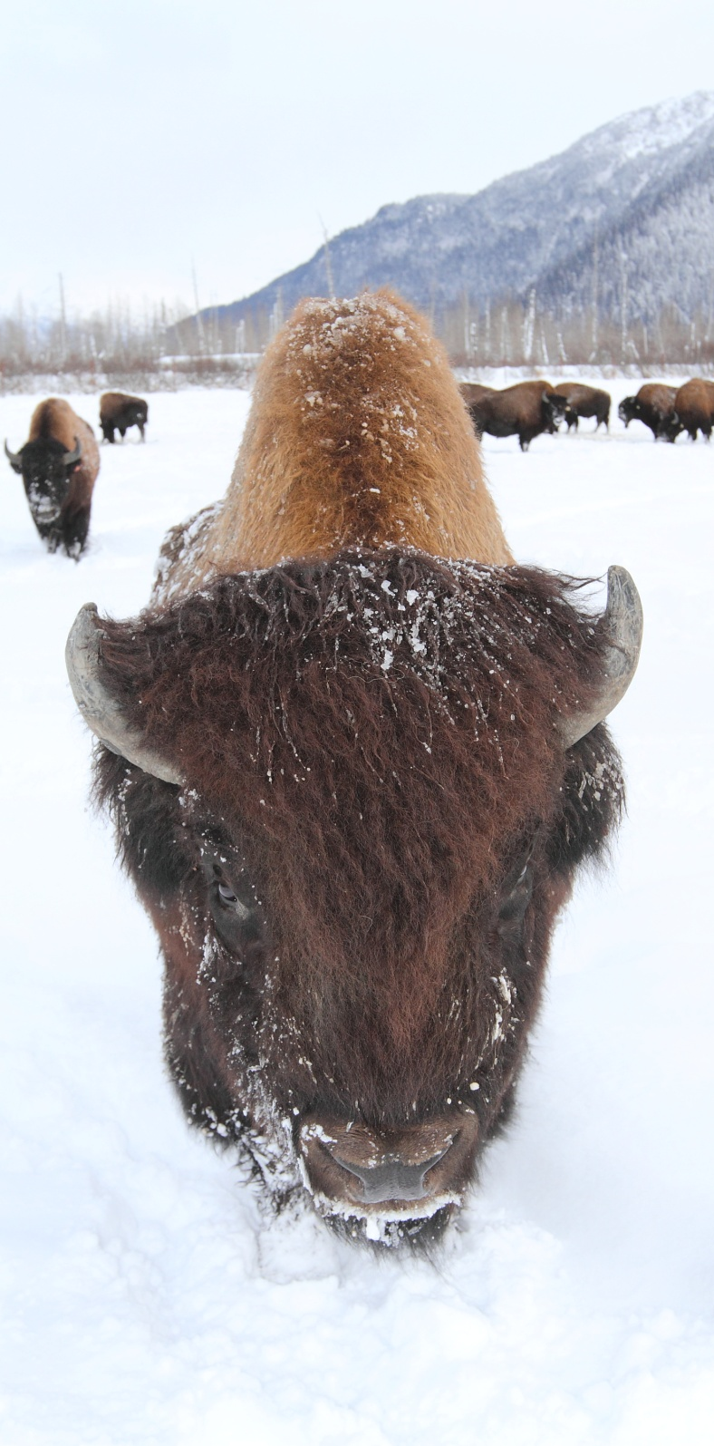
Background Info
But, restoring a species that is listed as
endangered or threatened can take a
long time
Why?
One reason
Threatened and endangered species are protected under the Endangered Species Act and managed by the US Fish and Wildlife Service
So, any restoration plans at the STATE level must be evaluated and approved at the FEDERAL level by the US Fish and Wildlife Service…..and that takes time

Slide 7
Background Info
But, restoring a species that is listed as
endangered or threatened can take a
long time
Why?
Another reason
Because threatened species are protected, some land owners near potential wood bison restoration sites might be worried that they will lose some of their land use rights……
….so it takes time to make sure landowners, industries, the State, and Alaska Natives are okay with the wood bison restoration plan

Slide 8
Background Info
To address the landowner concerns, the US
Fish and Wildlife Service and the Alaska Dept.
of Fish & Game have come up with a draft
of a special rule that would designate
wood bison as a “non-essential,
experimental” population in Alaska
What does THIS mean?
It means that if wood bison herds are restored in Alaska, then “the bison herds will not have any unintended consequences for the State of Alaska, Alaska Natives, industry (like mining), or private landowners”

Slide 9
Background Info
To address the landowner concerns, the US
Fish and Wildlife Service and the Alaska Dept.
of Fish & Game have come up with a draft
of a special rule that would designate
wood bison as a “non-essential,
experimental” population in Alaska
What does THIS mean?
It also means that the state of Alaska will manage any future wood bison hunting

Slide 10
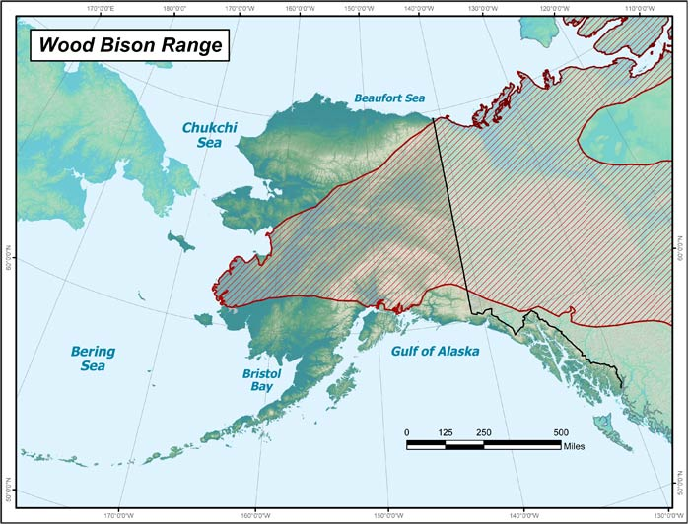
Background Info
As soon as this special rule is figured out,
the plan is to restore the captive wood
bison herd that is living at Alaska Wildlife Conservation Center back into portions of
the historic wood bison range in Alaska
?
?
?
?
But WHERE in the historic wood bison range should we restore wood bison?

Slide 11
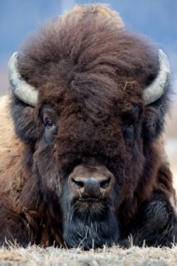
Where will the wood bison roam?
Wood Bison Range
?
?
?
?

Slide 12
Where will the wood bison roam?
To answer this question, biologists with the Alaska Department of Fish and Game recently conducted a study
For this study, biologists looked at the historic wood bison range in Alaska and identified 6 sites that MIGHT be good for wood bison restoration
Then, the biologists collected data (information) at each of the 6 potential wood bison release sites
Biologists used data to decide which of the 6 potential sites would be suitable for wood bison restoration
Let’s take a look!
What data did the biologists collect?

Slide 13
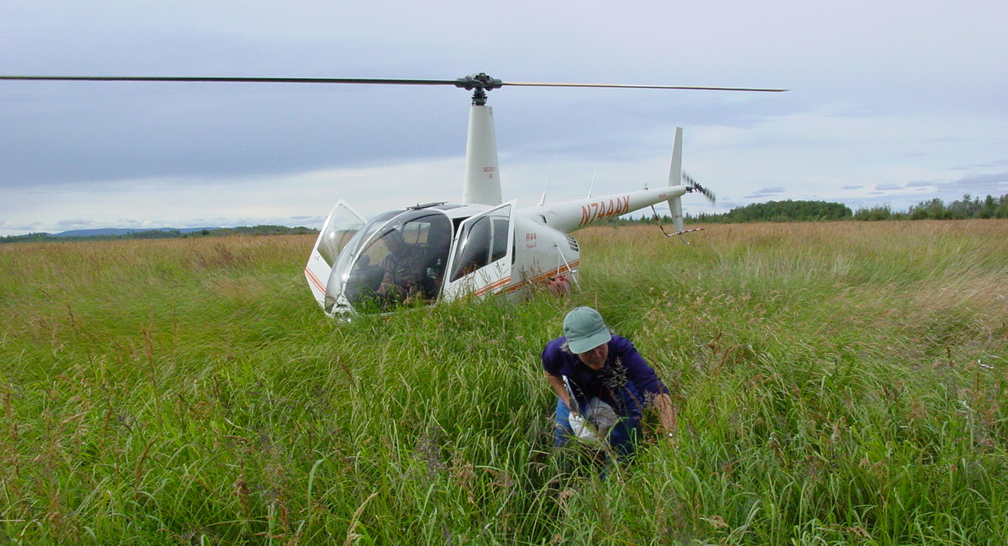
Where will the wood bison roam?
The biologists collected the following data (information)
at each of the six potential sites for wood bison restoration:
Photo credit: Mike Taras/ADF&G

Slide 14
Where will the wood bison roam?
The biologists collected the following data (information)
at each of the six potential sites for wood bison restoration:
1. Amount of meadow habitat in the site
YOU will be using the data that the biologists collected to help determine which of the potential sites are suitable for wood bison restoration
2. Availability of wood bison forage in the site’s meadows
3. Accessibility of wood bison forage in the site
4. Size of the site
Before you use the data, let’s take a quick look at each Data Category
5. Proximity of the site to existing PLAINS bison herds
6. Landownership in and near the site

Slide 15
Where will the wood bison roam?
DATA CATEGORIES
Let’s look at this one first
1. Amount of meadow habitat in the site
2. Availability of wood bison forage in the site’s meadows
3. Accessibility of wood bison forage in the site
4. Size of the site
5. Proximity of the site to existing PLAINS bison herds
6. Landownership in and near the site

Slide 16
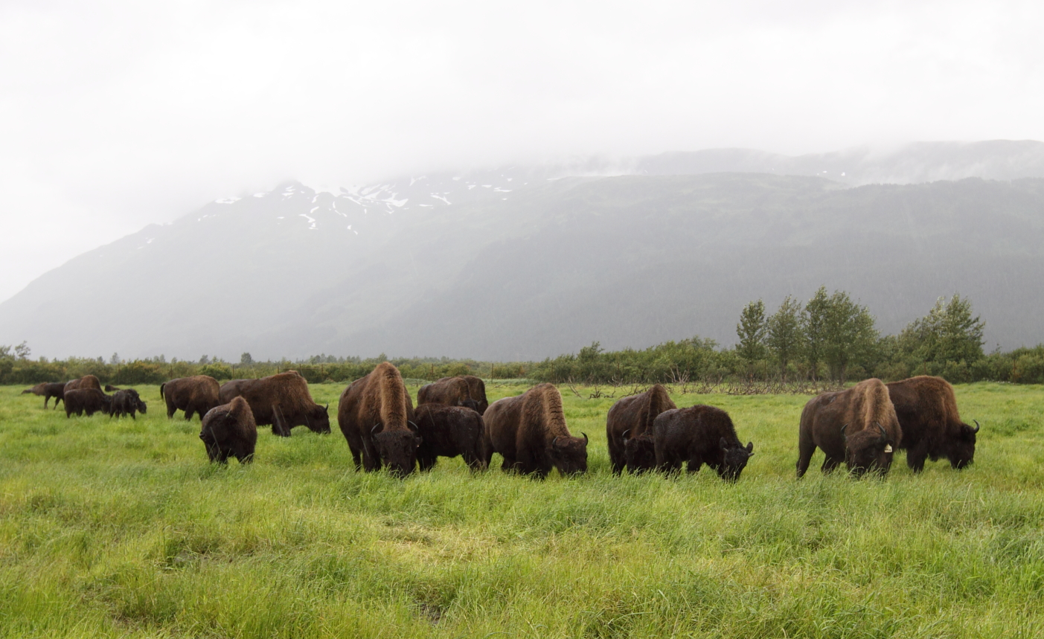
Where will the wood bison roam?
1. Amount of meadow habitat in the site
Wood bison use a variety of habitats throughout the year…..
…..but they prefer wet and mesic grass/sedge meadows
In fact, wood bison do not occupy areas where grass/sedge
meadows are absent
So, the wood bison restoration site must include a sufficient amount of grass/sedge meadows

Slide 17
Where will the wood bison roam?
1. Amount of meadow habitat in the site
COOL FACT
We usually think about habitat in terms of how habitat AFFECTS
animals (what foods and other resources does a habitat provide?)
Habitat is the place where an animal lives
Habitat provides all the resources
an animal needs to survive and reproduce

Slide 18
Where will the wood bison roam?
1. Amount of meadow habitat in the site
COOL FACT
We usually think about habitat in terms of how habitat AFFECTS
animals (what foods and other resources does a habitat provide?)
For example……
meadow habitat AFFECTS wood bison by providing
food (sedges and grasses) for wood bison to eat
the wood bison is a KEY GRAZING ANIMAL that
AFFECTS habitat , too!
Well……
How?
The wood bison’s grazing, hoof disturbance, and wallowing increase plant diversity, productivity, and nutrient cycling---which helps maintain meadow habitat

Slide 19
Where will the wood bison roam?
1. Amount of meadow habitat in the site
Okay, we know a bit about meadow habitat
Let’s move on to the next DATA CATEGORY

Slide 20
Where will the wood bison roam?
DATA CATEGORIES
This one next!
1. Amount of meadow habitat in the site
2. Availability of wood bison forage in the site’s meadows
3. Accessibility of wood bison forage in the site
4. Size of the site
5. Proximity of the site to existing PLAINS bison herds
6. Landownership in and near the site

Slide 21
Where will the wood bison roam?
2. Availability of wood bison forage in the site’s meadows
What types of FORAGE do wood bison eat?

Slide 22
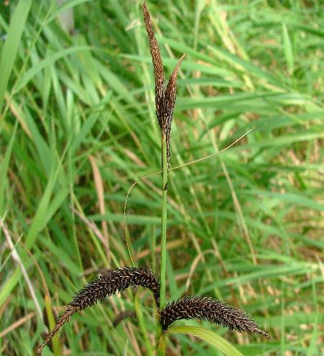
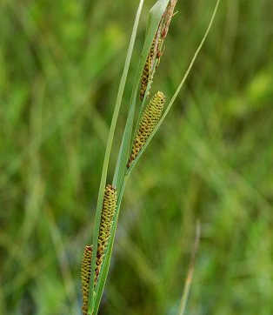
Where will the wood bison roam?
2. Availability of wood bison forage in the site’s meadows
What types of FORAGE do wood bison eat?
Wood bison are generalist herbivores…...
…..but they eat plants high in protein content first
Wood bison eat mostly GRAMINOIDS (93% of their diet)
Sedges and Grasses
What are GRAMINOIDS?
Plants with elongated leaves
that are sod forming or tufted
Examples of GRAMINOIDS:
Slough sedge
Water sedge
Beaked sedge
Reed grass
Wood bison select slough sedge and eat this first if it is available
Dave Rogers/iRiver Refuge Seed
kgNaturePhotography

Slide 23
Where will the wood bison roam?
2. Availability of wood bison forage in the site’s meadows
What types of FORAGE do wood bison eat?
Wood bison eat other things, too:
Willow leaves and willow bark
Lichen
Some flowers
Wood bison select different FORAGE seasonally
EARLY SUMMER: wood bison eat primarily grasses and
willow leaves
LATE SUMMER and WINTER: wood bison eat mainly sedges

Slide 24
Where will the wood bison roam?
DATA CATEGORIES
1. Amount of meadow habitat in the site
2. Availability of wood bison forage in the site’s meadows
Time for this one!
3. Accessibility of wood bison forage in the site
4. Size of the site
5. Proximity of the site to existing PLAINS bison herds
6. Landownership in and near the site

Slide 25
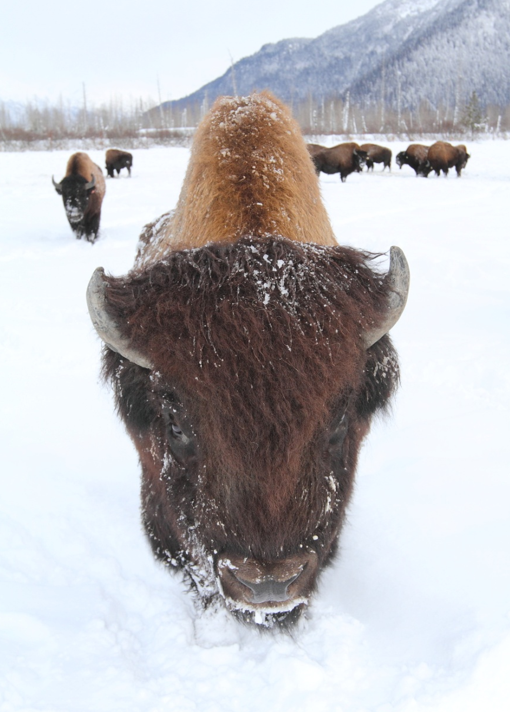
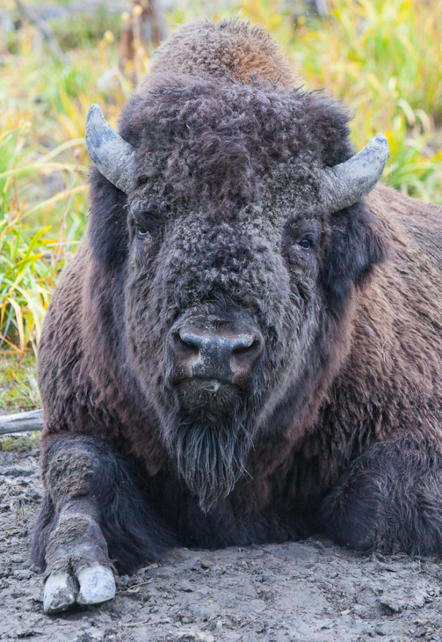
Where will the wood bison roam?
3. Accessibility of wood bison forage in the site
In winter, wood bison use their heads to
push snow out of the way to access food
If there’s too much snow or ice,
then wood bison cannot access food
In spring and summer, wood bison eat grasses and sedges in meadows
If the meadows are too boggy or wet,
then wood bison cannot access food
because they are heavy and might SINK!

Slide 26
Where will the wood bison roam?
DATA CATEGORIES
1. Amount of meadow habitat in the site
2. Availability of wood bison forage in the site’s meadows
3. Accessibility of wood bison forage in the site
Let’s do this one next!
4. Size of the site
5. Proximity of the site to existing PLAINS bison herds
6. Landownership in and near the site

Slide 27
Where will the wood bison roam?
4. Size of the site
Wood bison need ROOM to roam and grow
The site where wood bison will be restored needs to be
large enough to support a viable bison population
Site B
Site A
Is Site A too small?
Is Site B large enough?

Slide 28
Where will the wood bison roam?
DATA CATEGORIES
1. Amount of meadow habitat in the site
2. Availability of wood bison forage in the site’s meadows
3. Accessibility of wood bison forage in the site
4. Size of the site
This one!
5. Proximity of the site to existing PLAINS bison herds
6. Landownership in and near the site

Slide 29
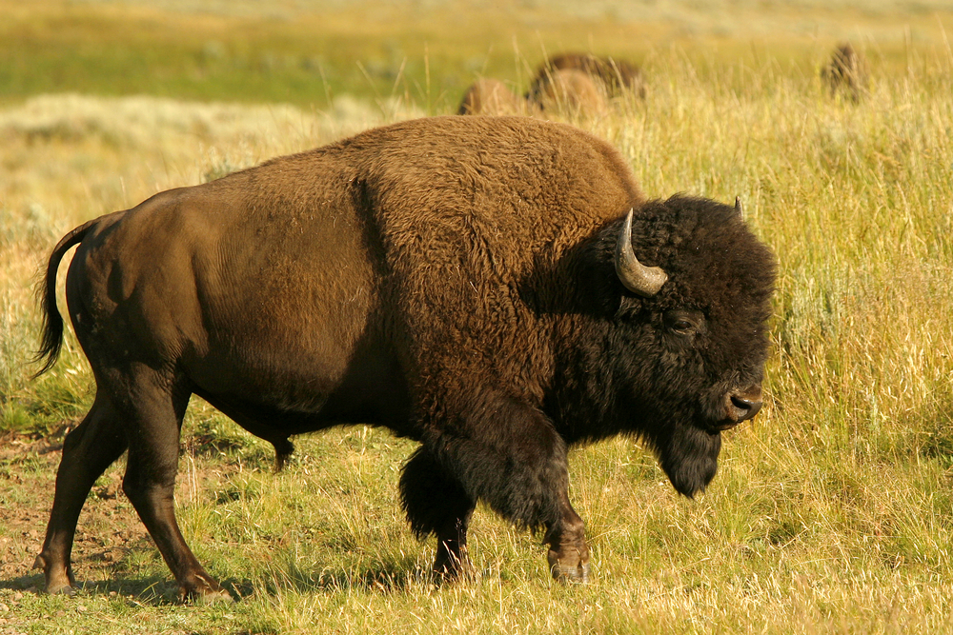
Where will the wood bison roam?
5. Proximity of site to existing PLAINS bison herds
It is important to separate
Wood Bison
from Plains Bison
because of possible hybridization, disease transfer and conflict
Wood Bison
Plains Bison

Slide 30
Where will the wood bison roam?
DATA CATEGORIES
1. Amount of meadow habitat in the site
2. Availability of wood bison forage in the site’s meadows
3. Accessibility of wood bison forage in the site
4. Size of the site
5. Proximity of the site to existing PLAINS bison herds
Here’s the last one!
6. Landownership in and near the site

Slide 31
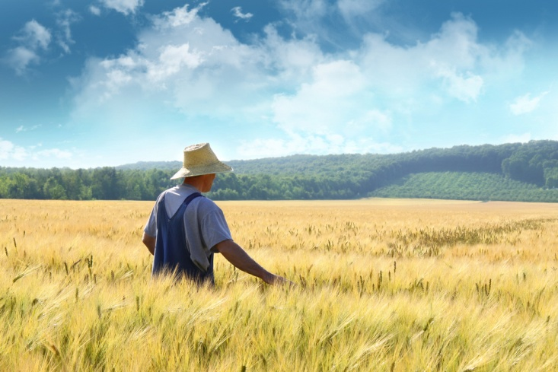
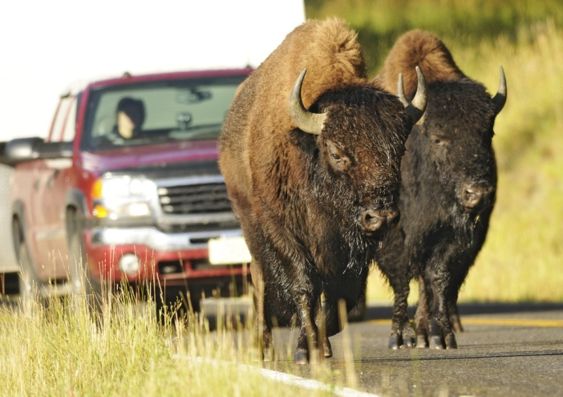
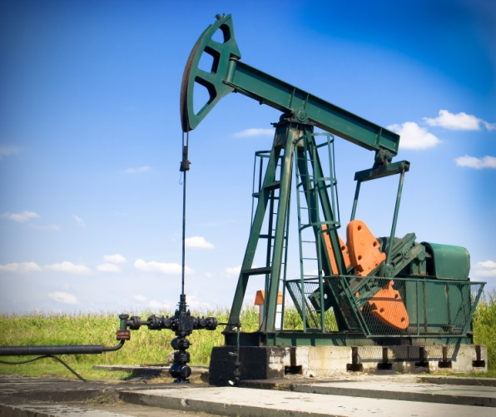
Where will the wood bison roam?
6. Landownership in and near the site
Who owns the land IN the potential site, and who owns
the land NEAR the potential site?
When restoring wood bison into the wild, it is important
to consider WHO might be affected by the wood bison
Farmers
Local residents
Mineral developers
Will bison trample
or eat crops?
Will bison cause road
concerns?
Will bison prevent oil
and gas extraction?

Slide 32
Where will the wood bison roam?
DATA CATEGORIES
Now it’s YOUR turn
1. Amount of meadow habitat in the site
2. Availability of wood bison forage in the site’s meadows
3. Accessibility of wood bison forage in the site
4. Size of the site
5. Proximity of the site to existing PLAINS bison herds
6. Landownership in and near the site

Slide 33
Where will the wood bison roam?
Let’s figure out where wood bison can be restored into the wild in Alaska
Now it’s YOUR turn
Step 1: Your teacher will divide the class into 6 groups
Step 2: Each group will be assigned one of the 6 data categories
Step 3: Each group will be given STUDENT PAGES to work through
Step 4: Each group will present their group findings to the class
Step 5: Using results from all group presentations, the class will
work together to determine which site or sites are
suitable for wood bison restoration

Slide 34
Where will the wood bison roam?
Let’s figure out where wood bison can be restored into the wild in Alaska
Now it’s YOUR turn
Remember: there are 6 data categories and 6 potential sites
for wood bison restoration
Here’s a list of the 6 potential sites:
Aniak River Site
Hogatza River Site
Innoko River Site
Minto Flats Site
North Fork Kuskokwim River Site
Yukon Flats Site

Slide 35
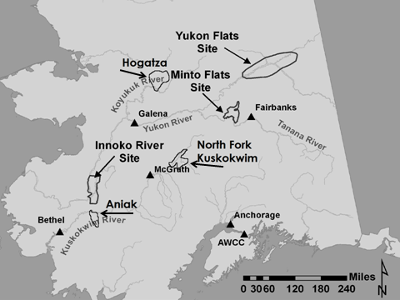
Where will the wood bison roam?
Here’s a map of the 6 potential sites:

Slide 36
Where will the wood bison roam?
Let’s get to work!
When you have finished working as a class to determine which site or sites are suitable for wood bison restoration, come back to this slide show to see if your answers match the RESULTS presented by the wood bison biologists

Slide 37
Where will the wood bison roam?
End of Slide Show
Part I

